Slide 1

IMAGE TAGGING AND ROAD OBJECT DETECTION
Guide : Prof. Anoop M. Namboodiri
Mentor : Sangeeth Reddy
• Richard Deepak
• Rahul Juluru
• Sridhar Deshpande
• Kshama Pandey

Slide 2
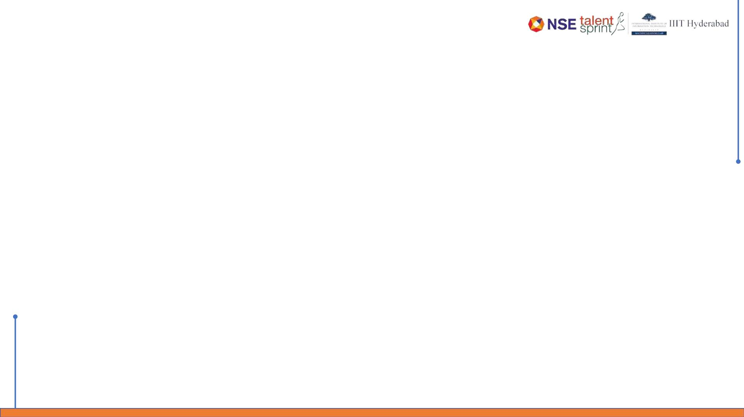
Agenda
• Objective
• Methodology and design considerations
• Outcome in stages with final outcome
• Challenges
• Application Demo

Slide 3
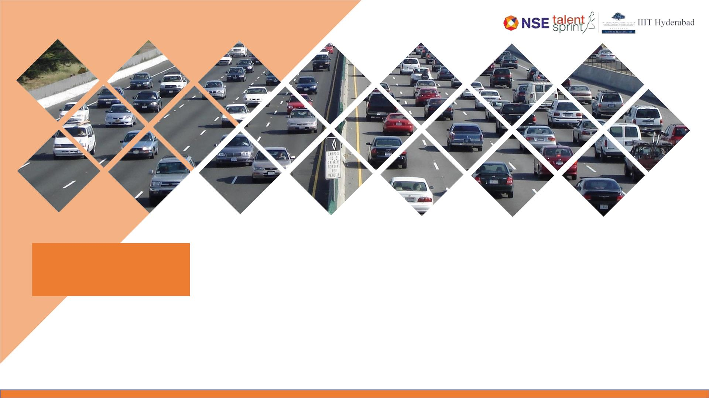
Objective
Build an application to detect multiple objects,
tag and tracking in a video.

Slide 4
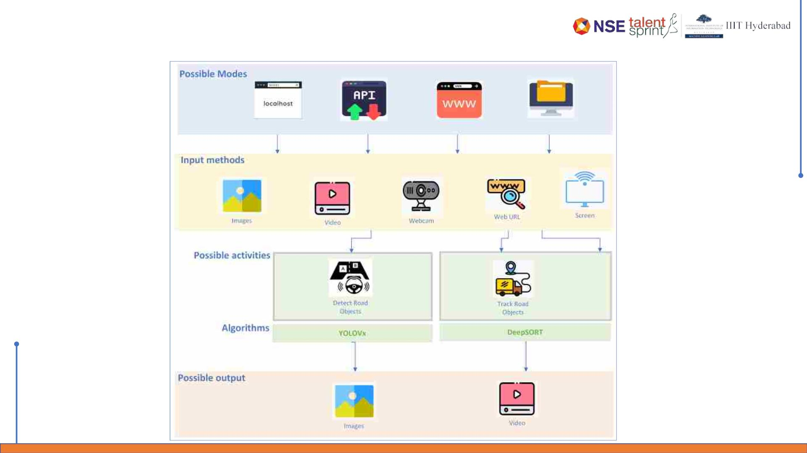
Methodology and design considerations

Slide 5
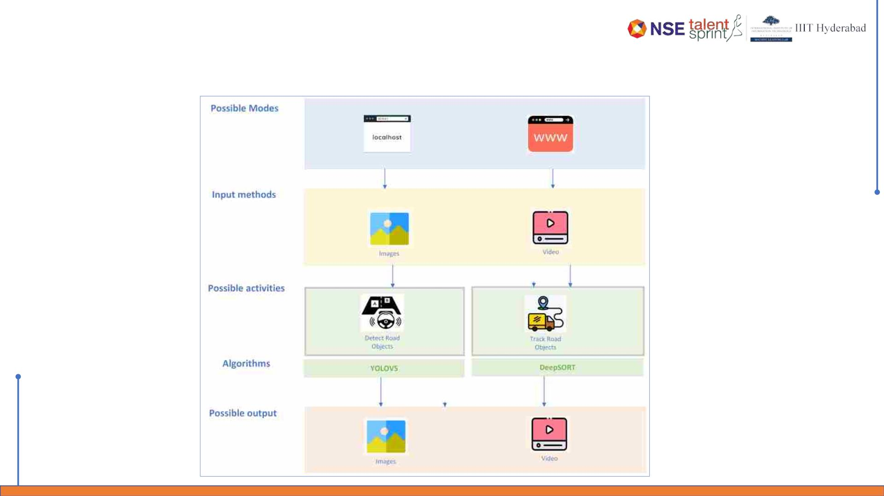
Methodology and design considerations
Project Scope

Slide 6

Outcome in stages
Understand the data
Learn about BDD100K dataset and download the images from
website. Load these images with labels in Google Drive for
further processing
Identify the object detection algorithm
Understand the repository with detailed analysis on the way
algorithm works and its efficiency. We have chosen YOLOv5 for
this purpose and understood steps for download its repository
Identify the tracking algorithm
We have chosen Deep SORT algorithm as our tracking algorithm as it
has greater efficiency and support community.
Process images & videos for object detection
Train , validate and test the BDD100K images & videos with YOLOv5
algorithm. Obtain the final model weights generated from the epoch which
can be the base for object detection.
Process tracking algorithm for videos
Test the BDD100K video samples downloaded form website to understand the
tracking efficiency after downloading their repo and run the required files.
Customize the solution to import essential packages / libraries.
Build the streamlit application and
deploy the solution
Develop the streamlit application to use the model weights for
object detection and tracking. Deploy the entire solution to
Streamlit Cloud after pushing entire solution to GIT repository.

Slide 7
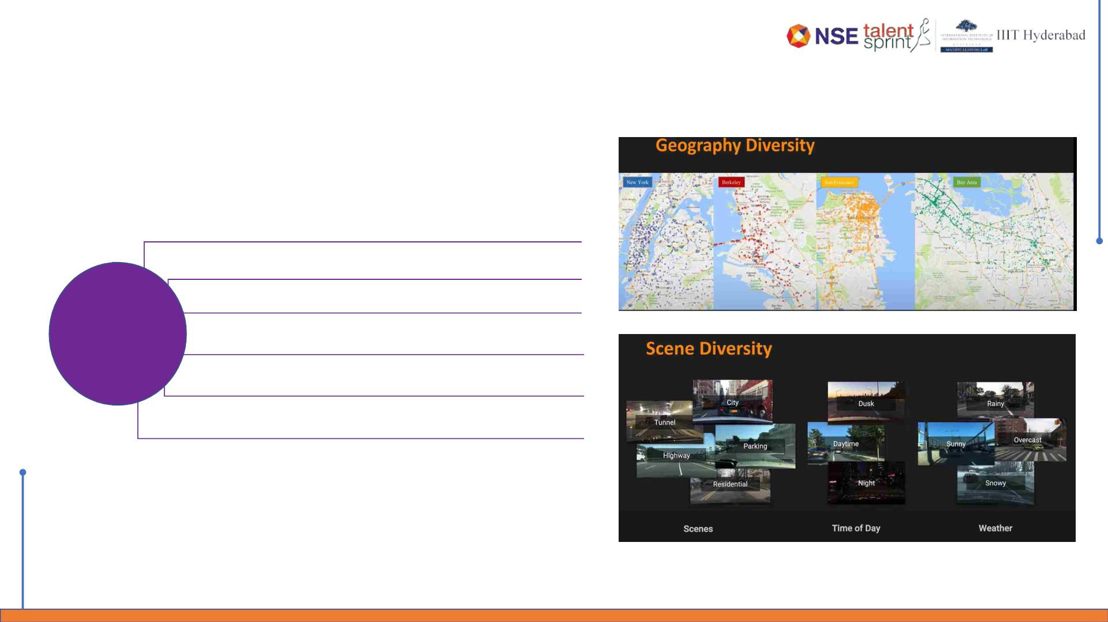
Outcome in stages
Stage 1 – Understand the data
Consists of 100,000 videos.
Each video is about 40 seconds long, 720p, and 30 fps
Geographically diverse
Scene Diversity : Scene = City , Tunnel , Highway , Parking , Residential
BDD100K
Dataset
Time of the day = Dusk , Daytime , night
Weather = Rainy , Sunny , Overcast , Snowy
There are >10 objects per image with pixel annotation and tracking

Slide 8
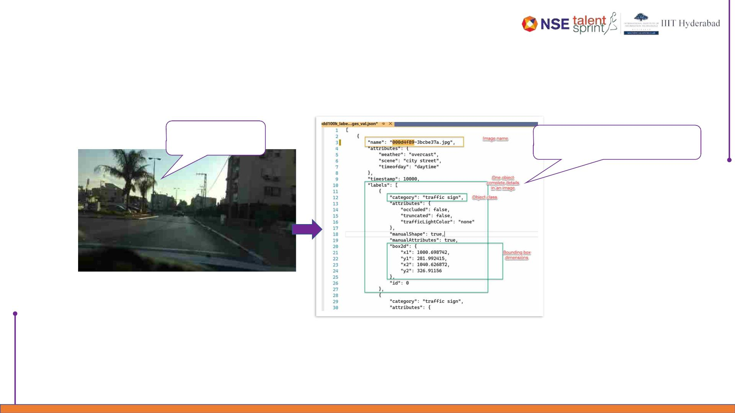
Outcome in stages
Stage 1 – Understand the data
Original Image
BDD100k dataset bounding box JSON
format

Slide 9
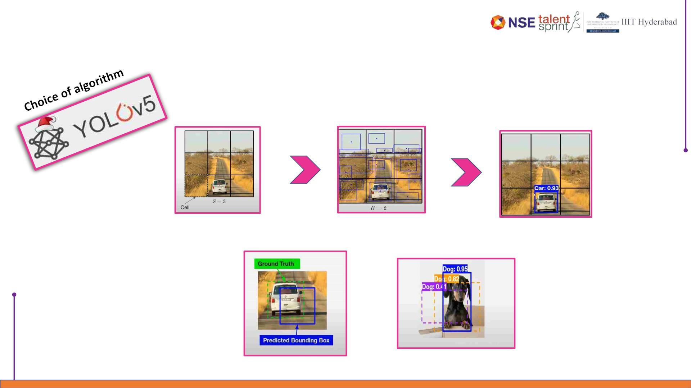
Outcome in stages
Stage 2 – Identify the object detection algorithm
Divide the image to cells
Predicting bounding boxes
within each cell
Selection of bounding box which is
above confidence threshold
Intersection over Union
Non max suppression

Slide 10
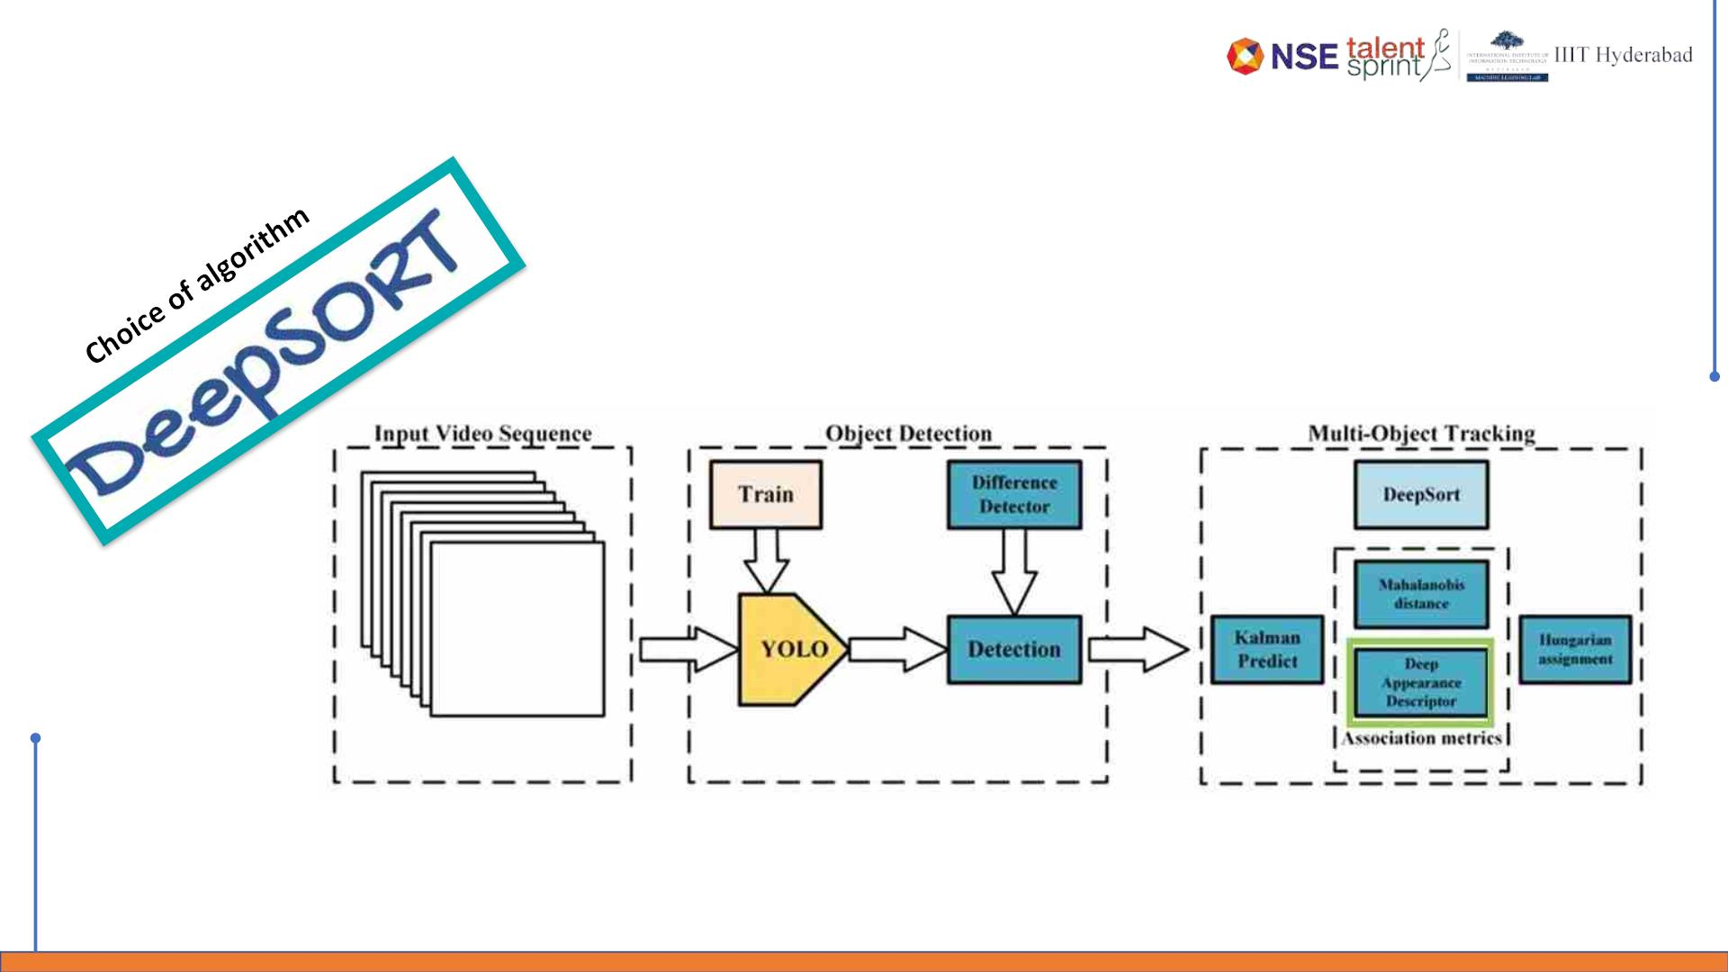
Outcome in stages
Stage 3 – Identify the tracking algorithm

Slide 11
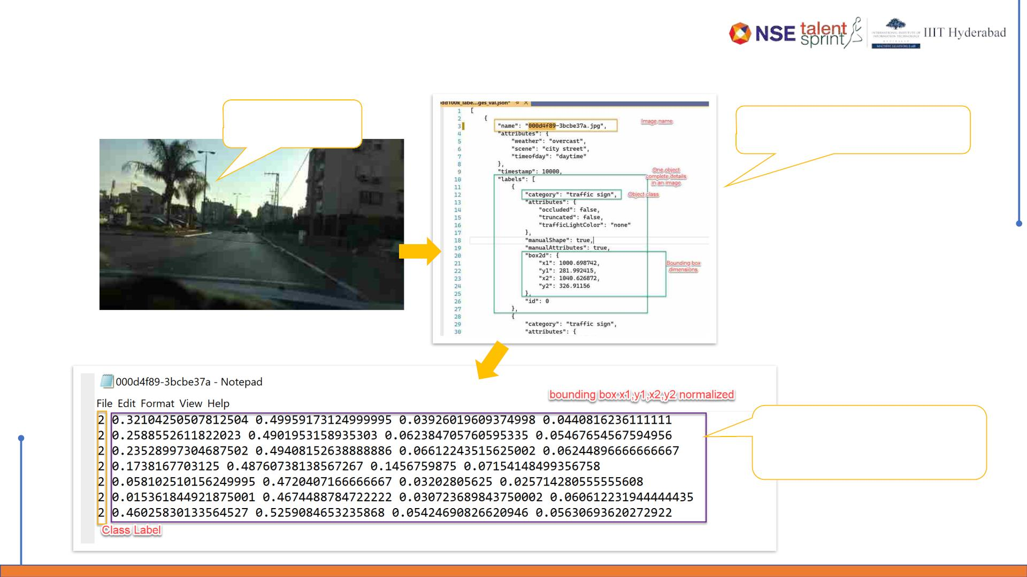
Outcome in stages
Stage 4 – Process images and videos for object detection
Original Image
BDD100k dataset bounding box JSON
format
Converted to TXT file with required
class and Bbox with mapping data and
labels

Slide 12
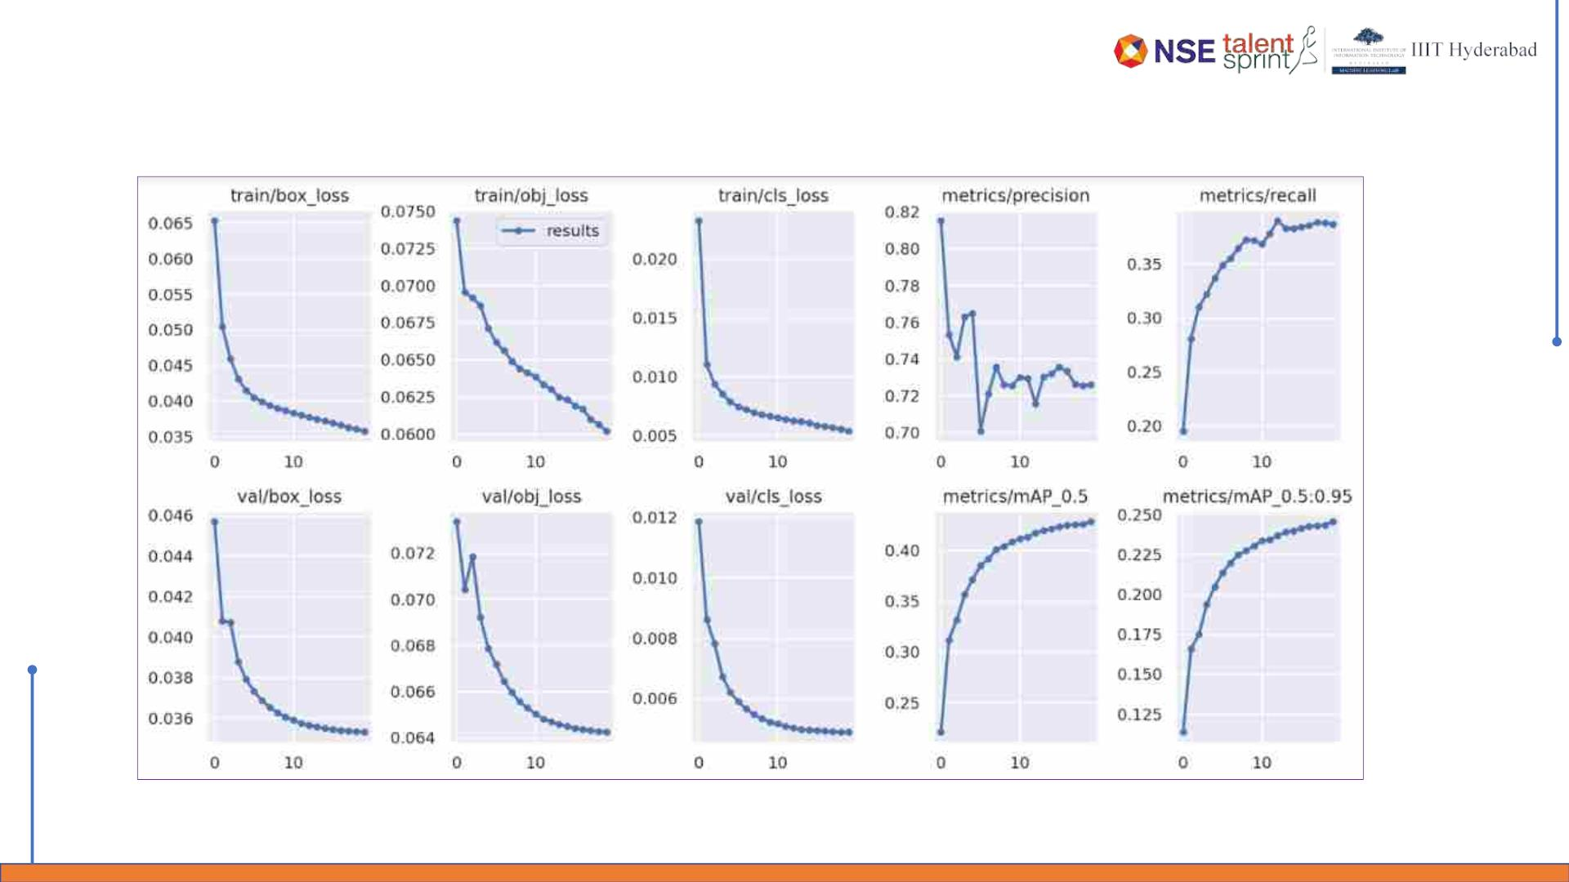
Actual Outcomes
Preliminary results

Slide 13
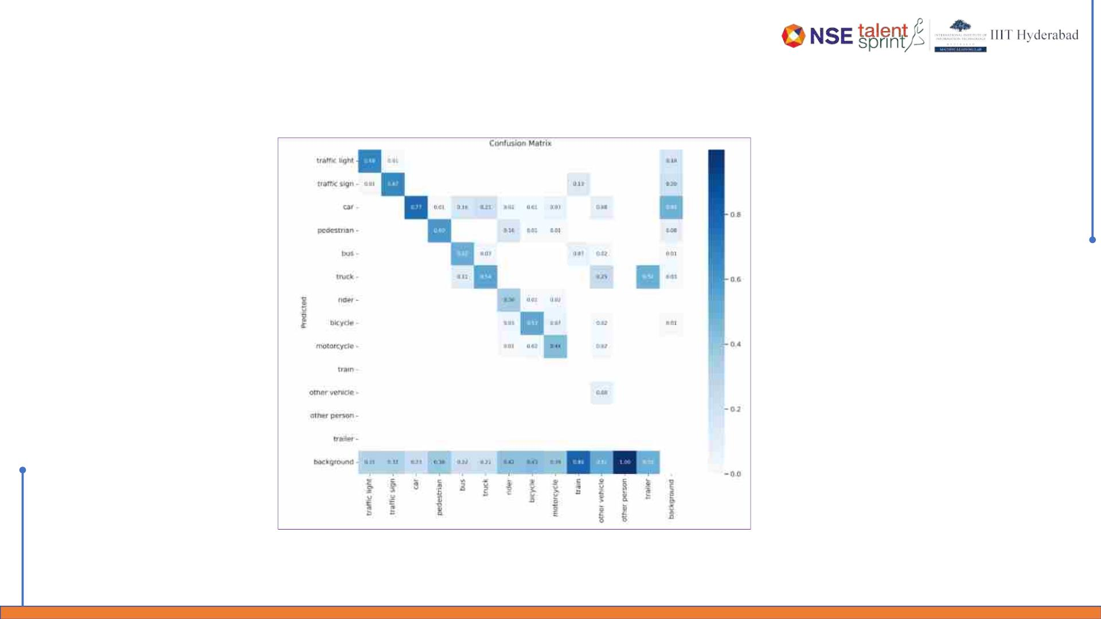
Actual Outcomes
Preliminary results – Confusion Matrix

Slide 14
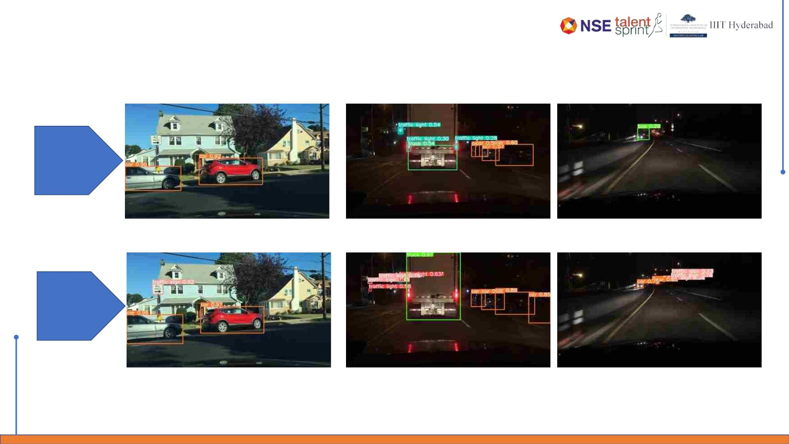
Actual Outcomes
YOLOv5 Object Detection
Pre-trained
COCO
dataset
After
BDD100K
dataset
training

Slide 15
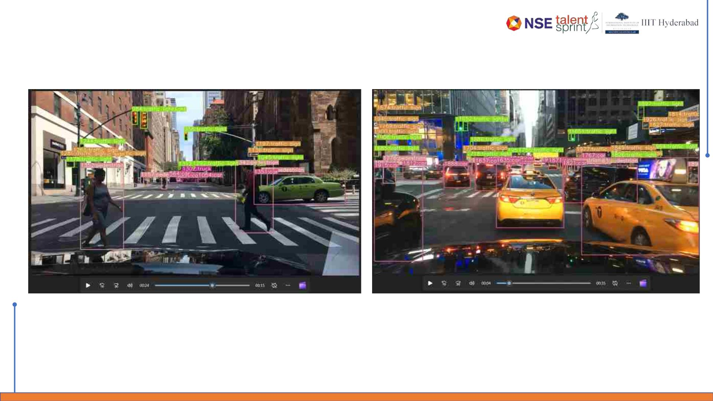
Outcome in stages
Stage 5 – Process videos for object tracking

Slide 16
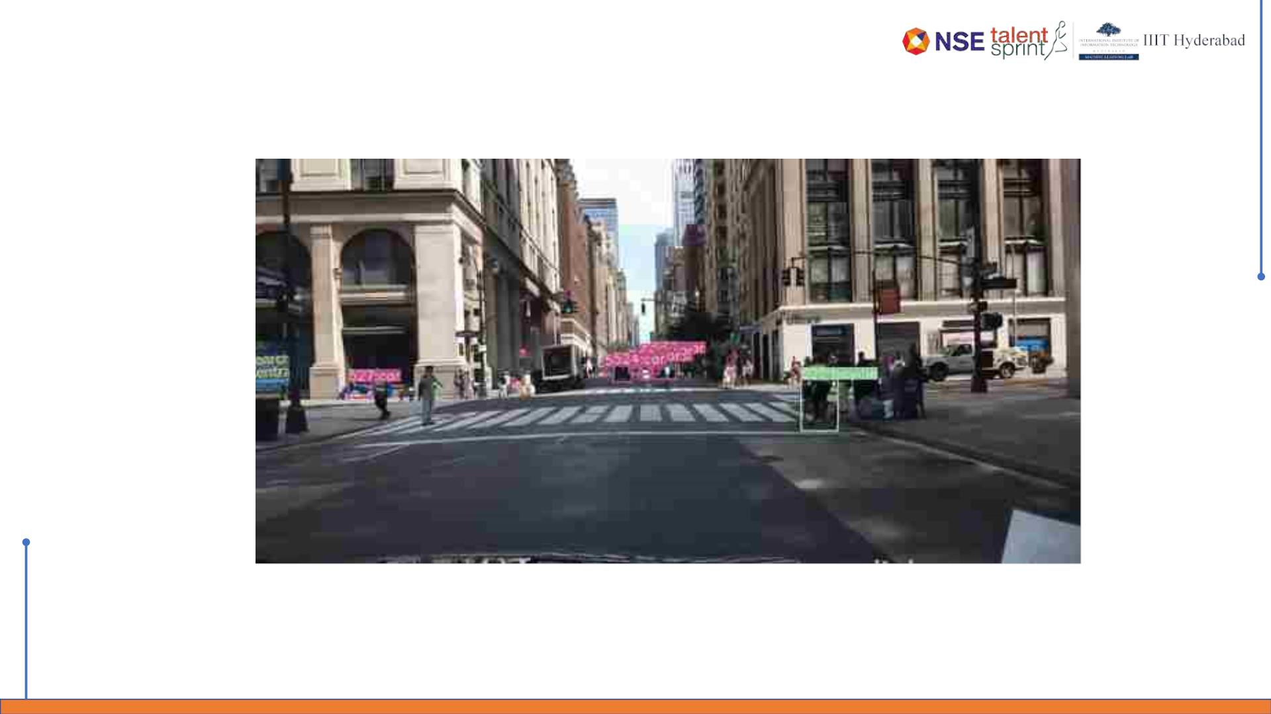
Actual Outcomes
YOLOv5 + Deep SORT tracker output
Tracked GIF via YOLOv5 + DeepSORT

Slide 17
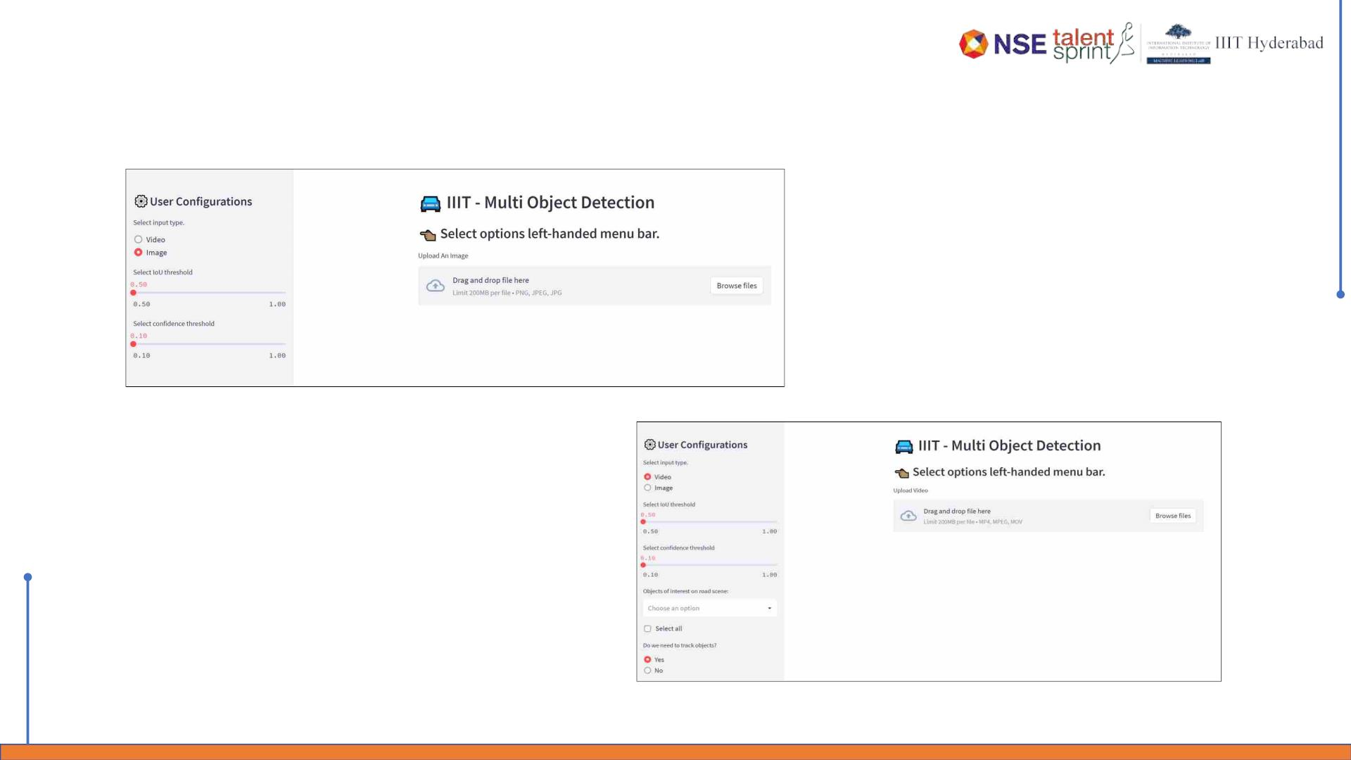
Outcome in stages
Stage 6 – Develop streamlit application and deploy onto Streamlit Cloud
Application for Image detection
Application for Video detection and tracking

Slide 18
Challenges
1. Missing labels for some of the images of BDD100k data.
2. Downloading of BDD100k videos were time consuming.
3. Resource constraint – GPU causing disconnection of runtime in colab.
4. Sharing GIT Code repositories
5. Understanding cloud constraints
6. Understanding installation of packages in streamlit cloud.
7. How to store the models so as to be loaded in the cloud environment.
8. Understanding Codec formats compatible with browsers.
9. Resource constraints while testing the web-UI locally.

Slide 19
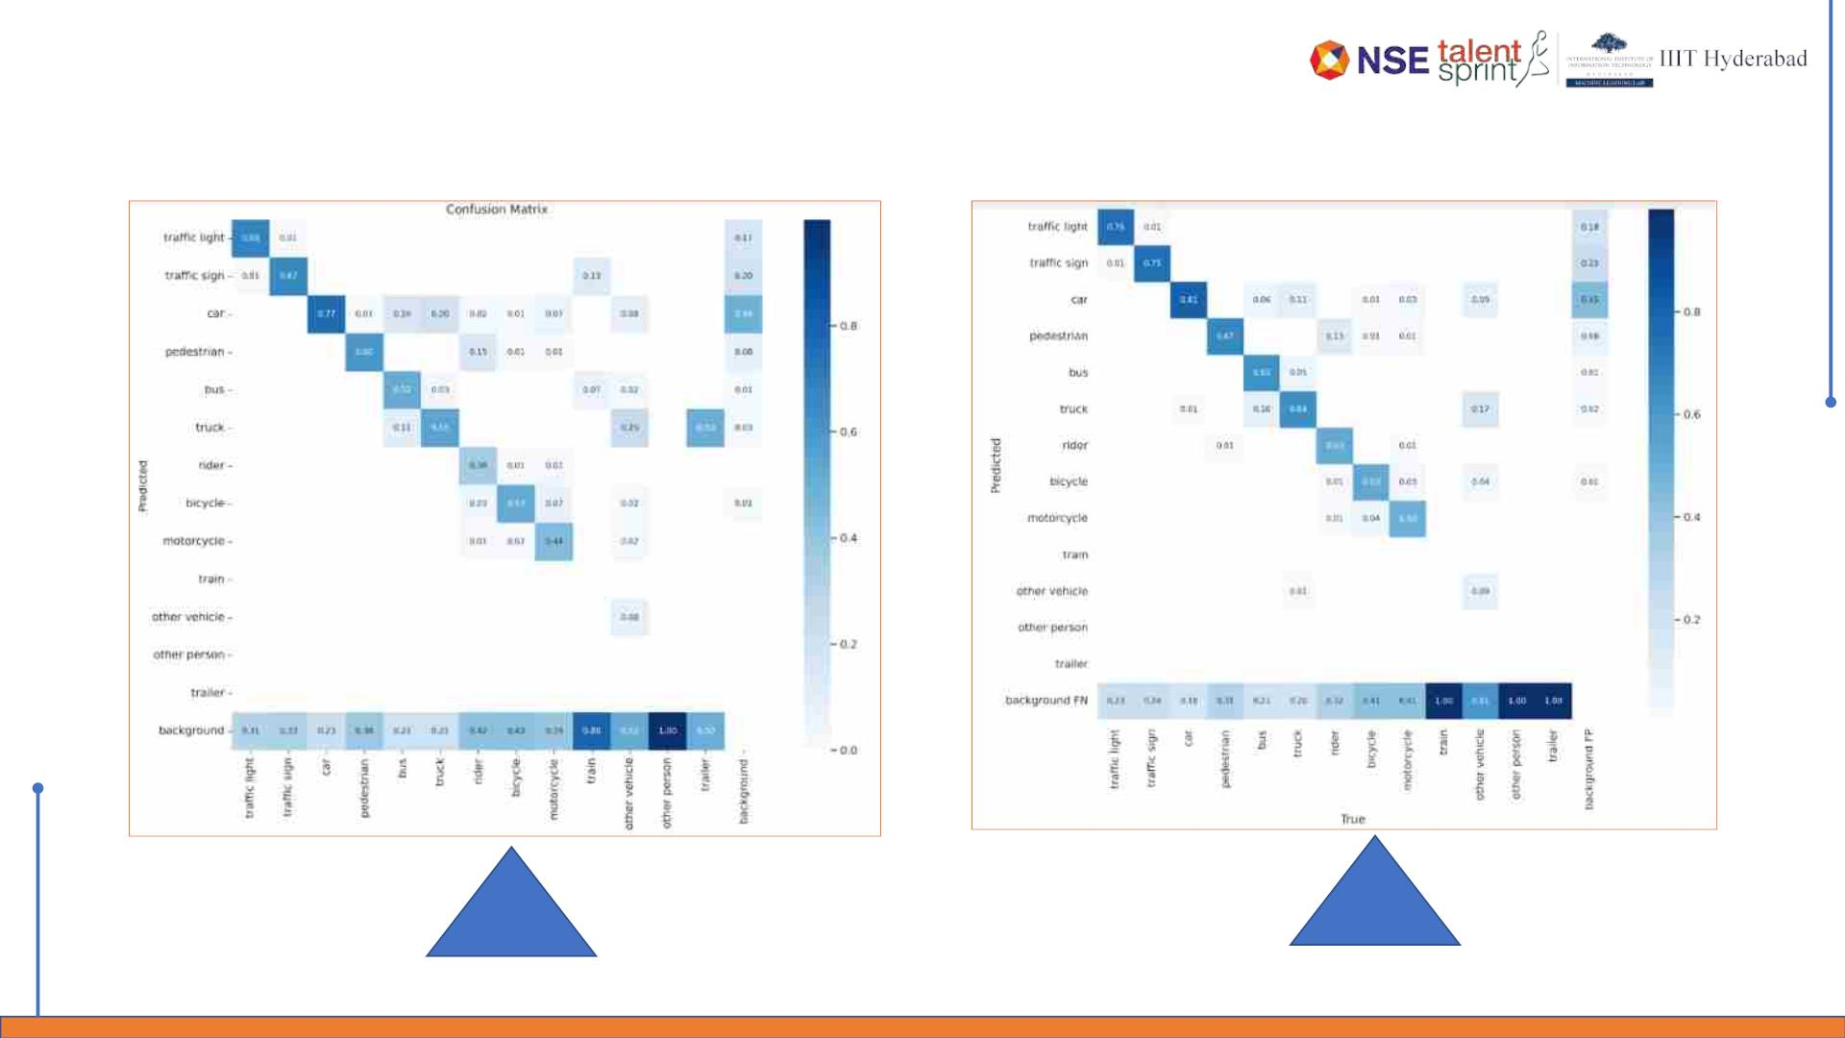
Stretch Goals
YOLOv5 vs YOLOv7
V5
V7

Slide 20
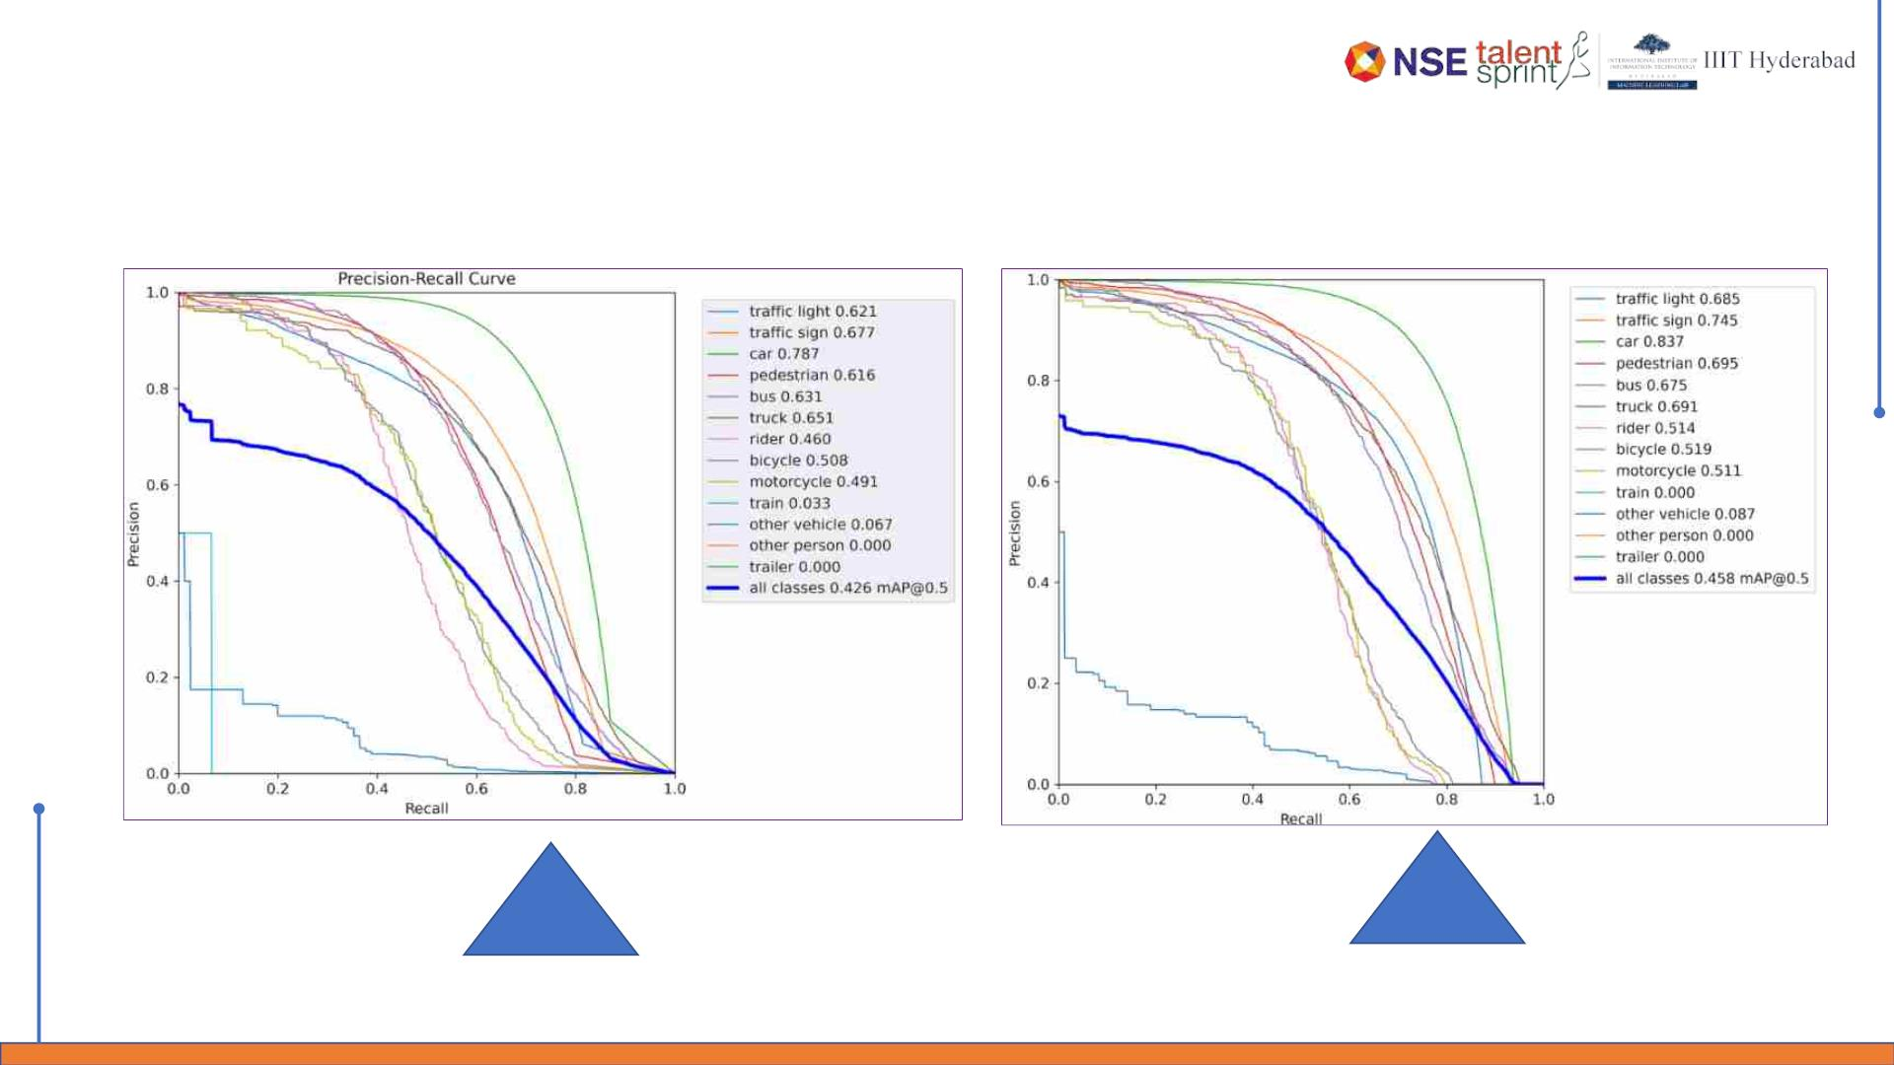
Stretch Goals
YOLOv5 vs YOLOv7
V5
V7

Slide 21
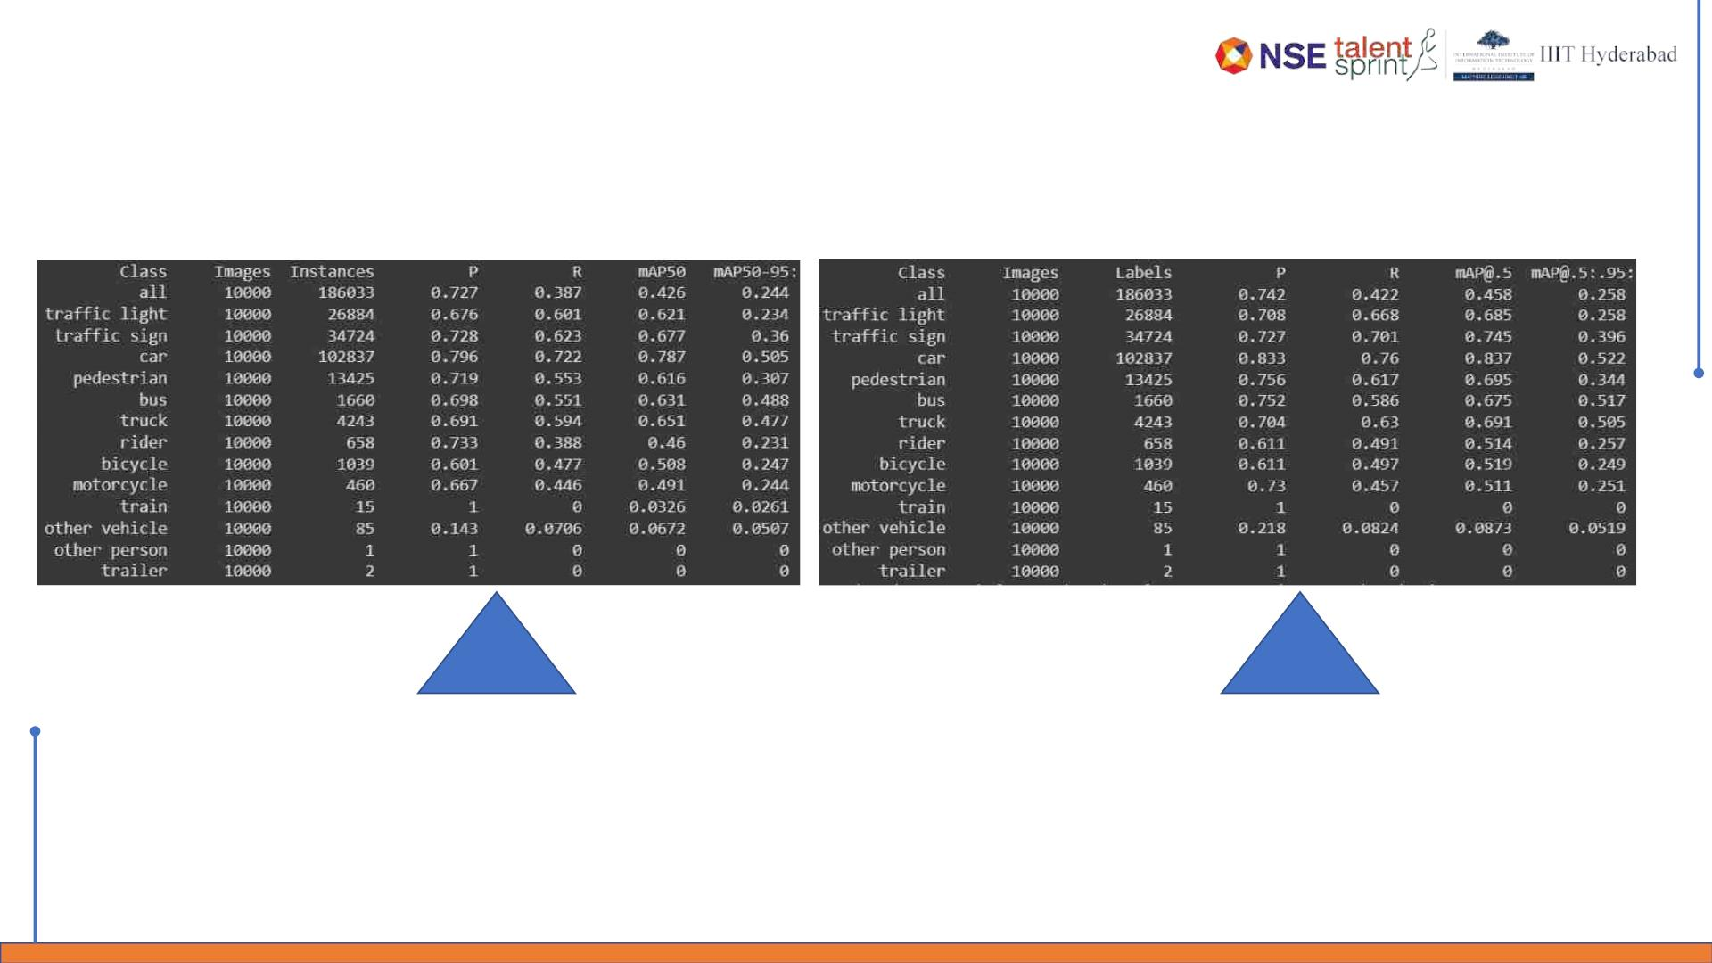
Stretch Goals
YOLOv5 vs YOLOv7
V5
V7

Slide 22
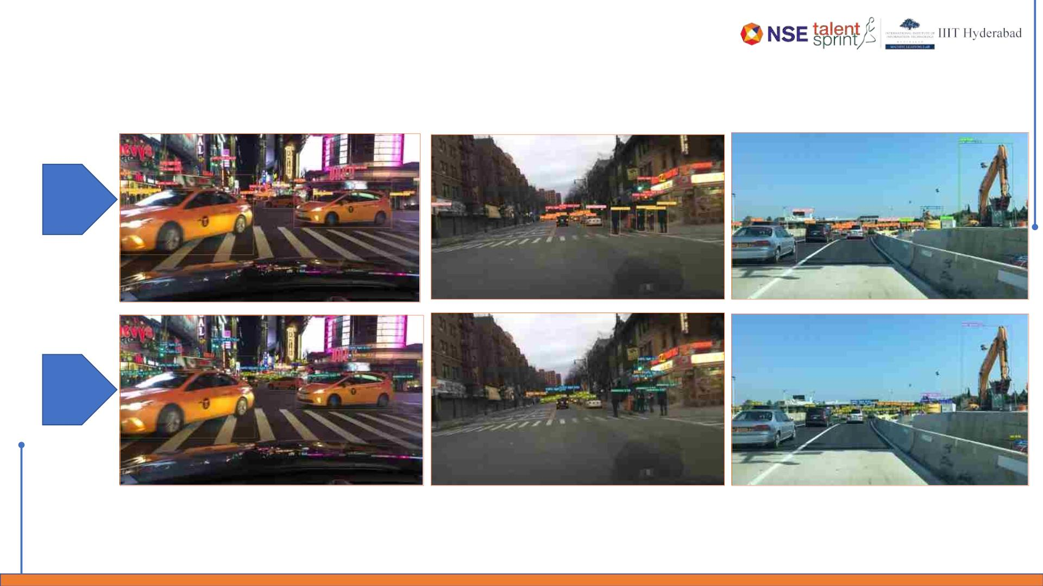
Stretch Goals
YOLOv5 vs YOLOv7
V5
V7

Slide 23
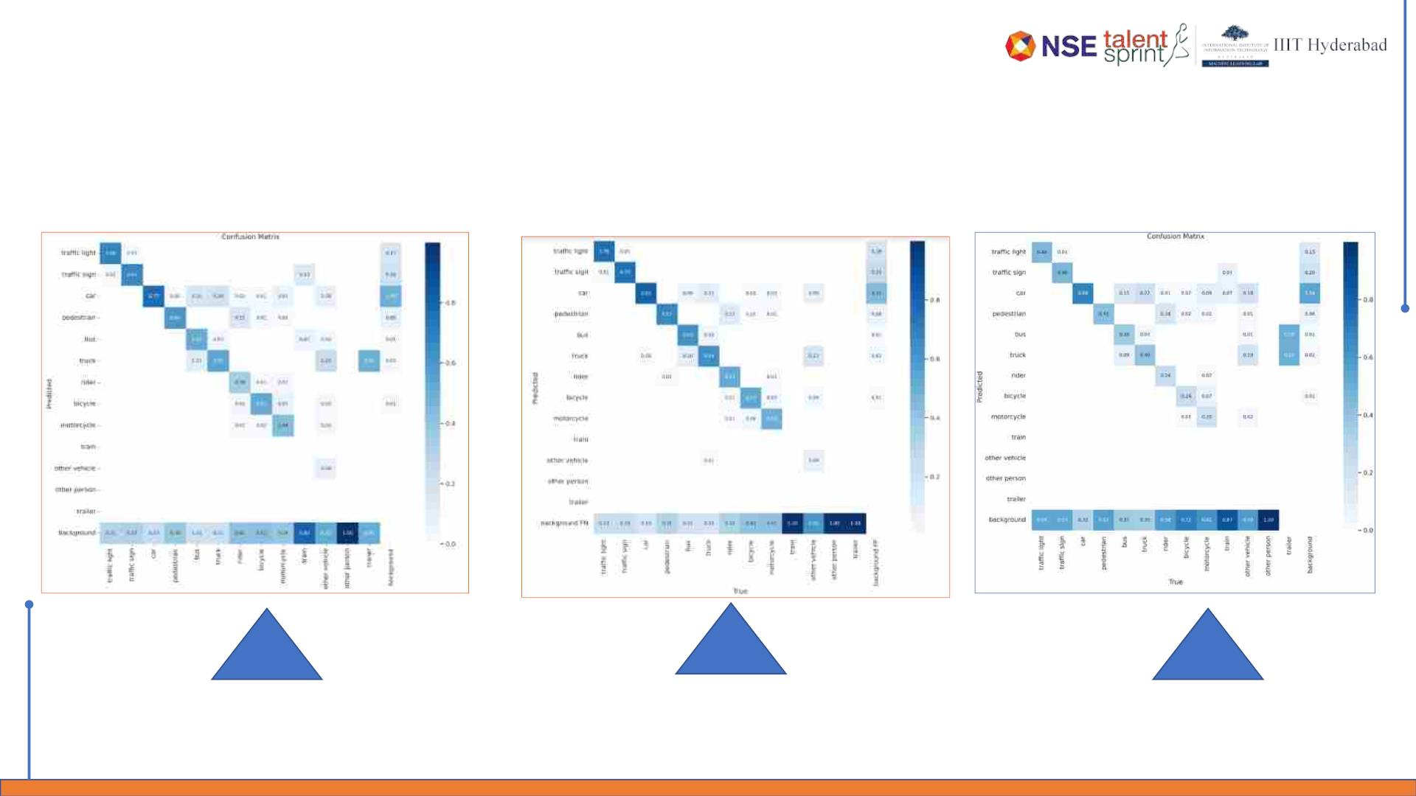
Stretch Goals
YOLOv5 vs YOLOv7 vs YOLOv8
(Trained v8 nano model architecture with all BDD100k data for 20 epochs)
V5
V7
V8

Slide 24
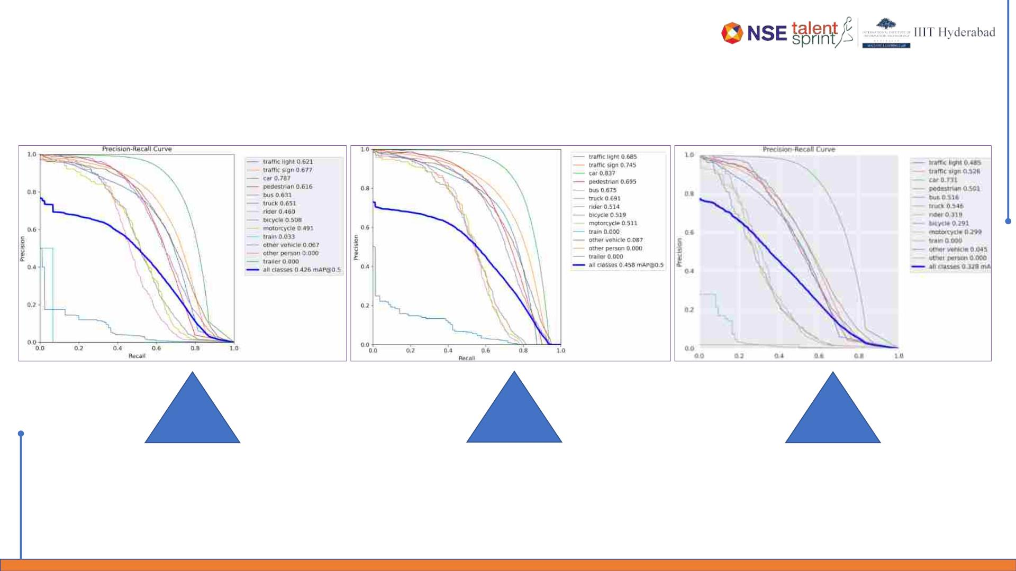
Stretch Goals
YOLOv5 vs YOLOv7 vs YOLOv8
V5
V7
V8

Slide 25
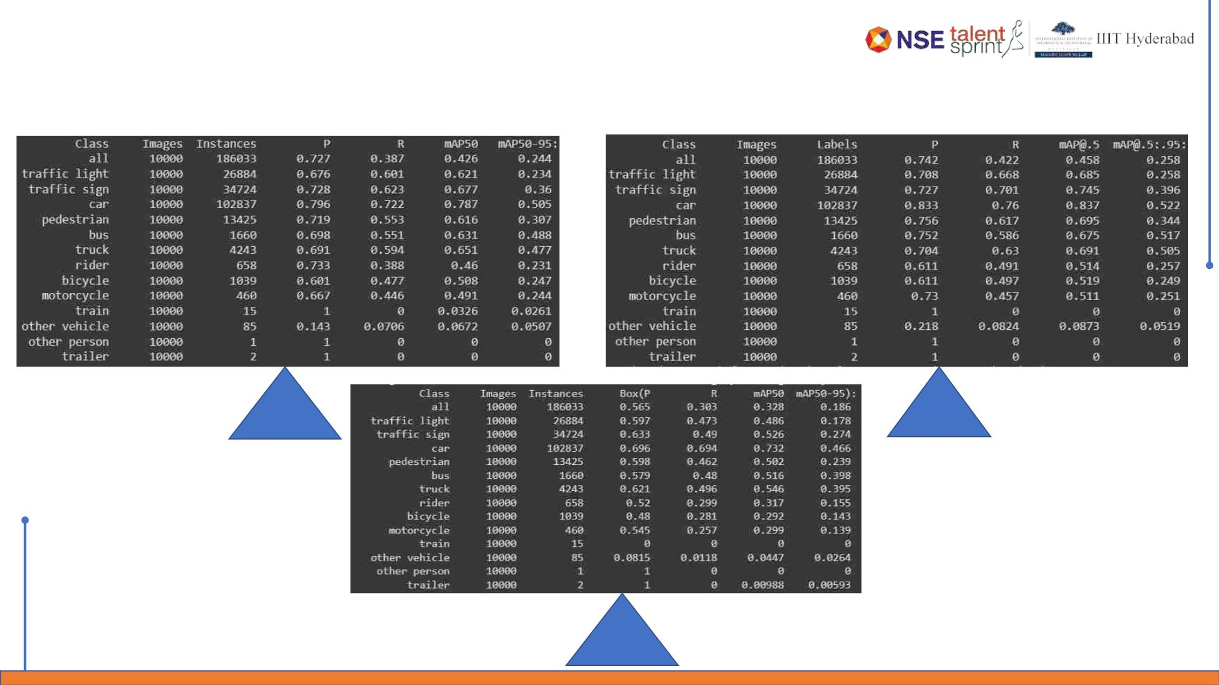
Stretch Goals
YOLOv5 vs YOLOv7 vs YOLOv8
V5
V7
V8

Slide 26
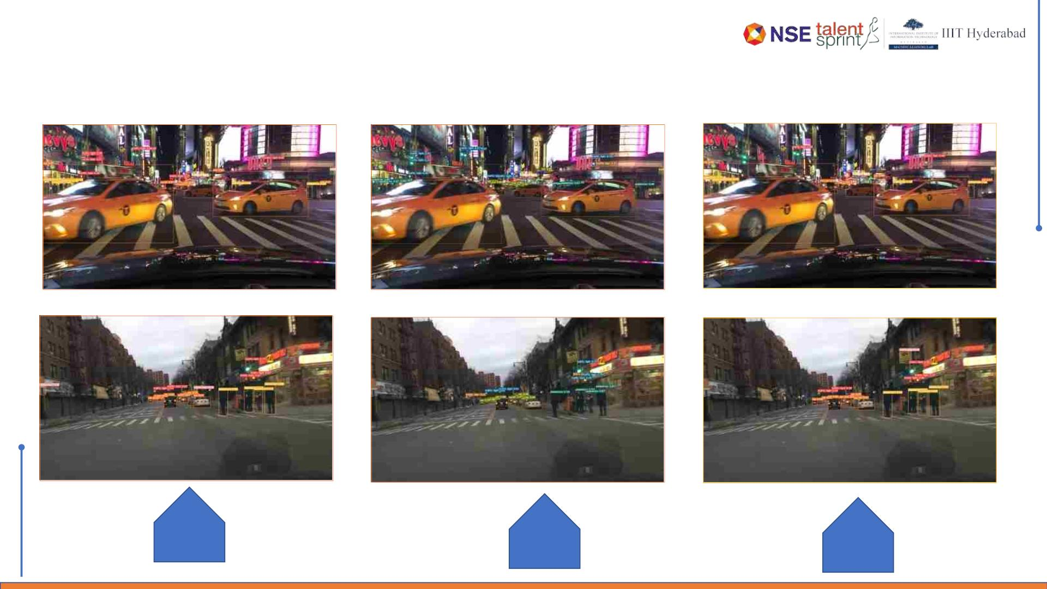
Stretch Goals
Explored YOLOv8
V5
V7
V8

Slide 27
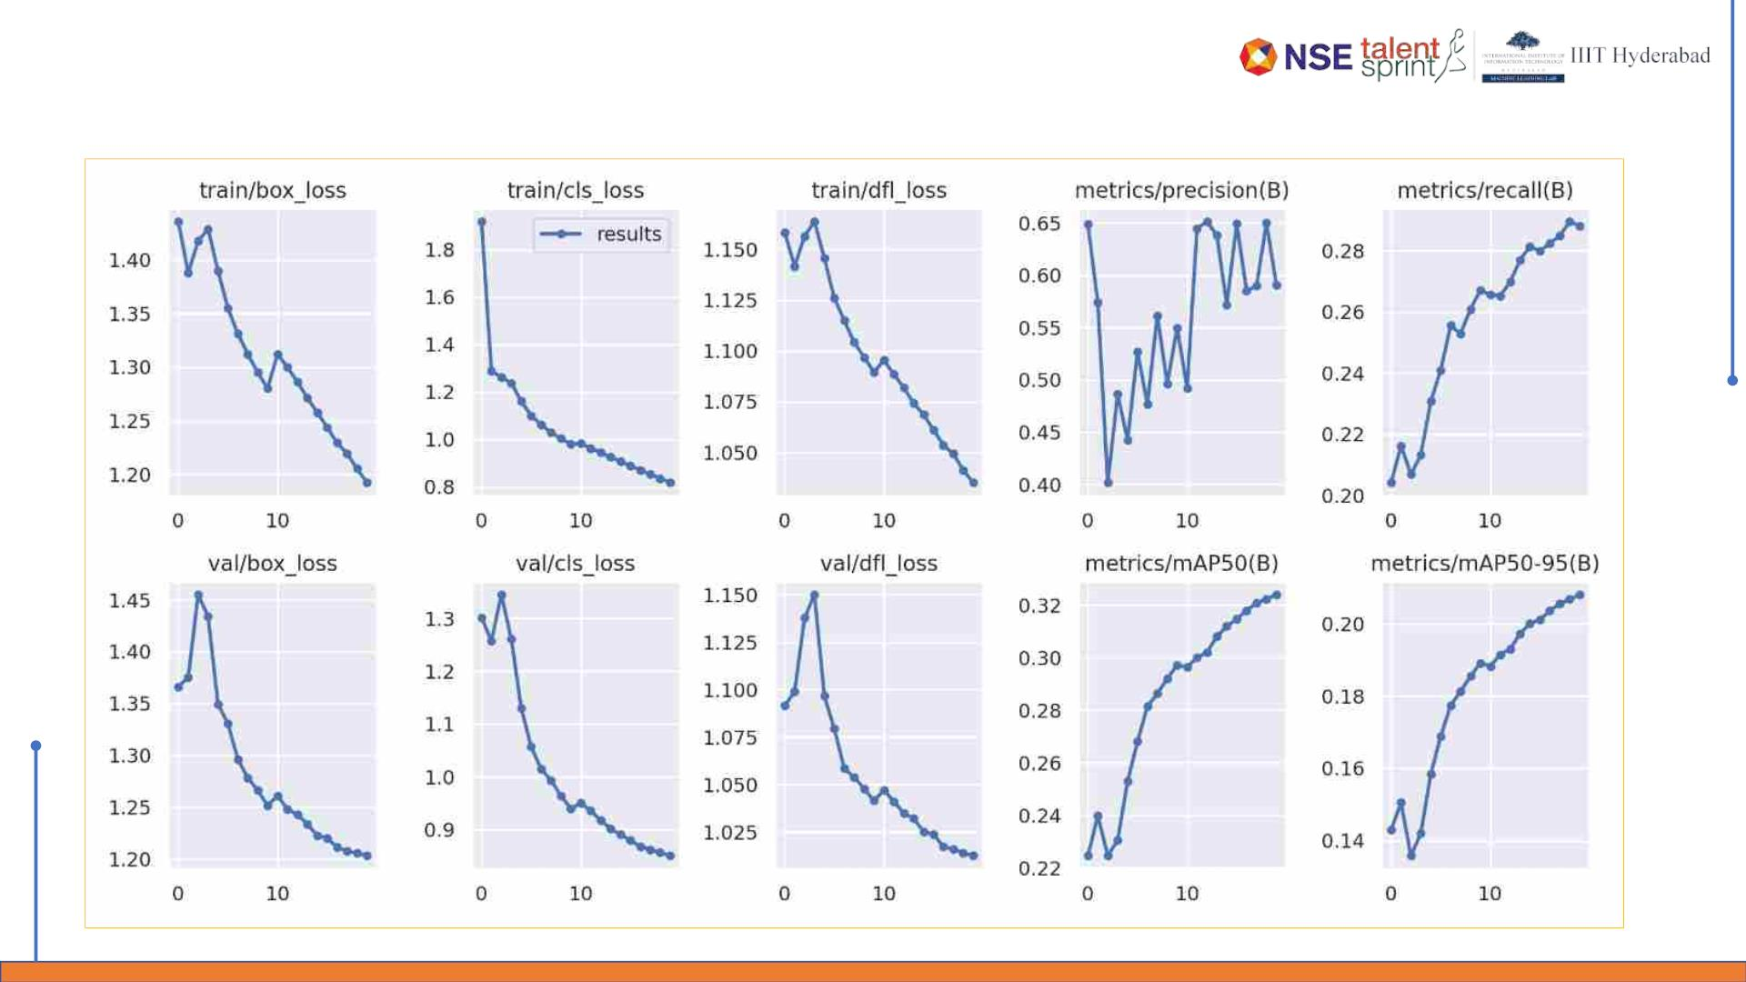
Actual Outcomes
YOLOv8 – Trained on IDD dataset

Slide 28
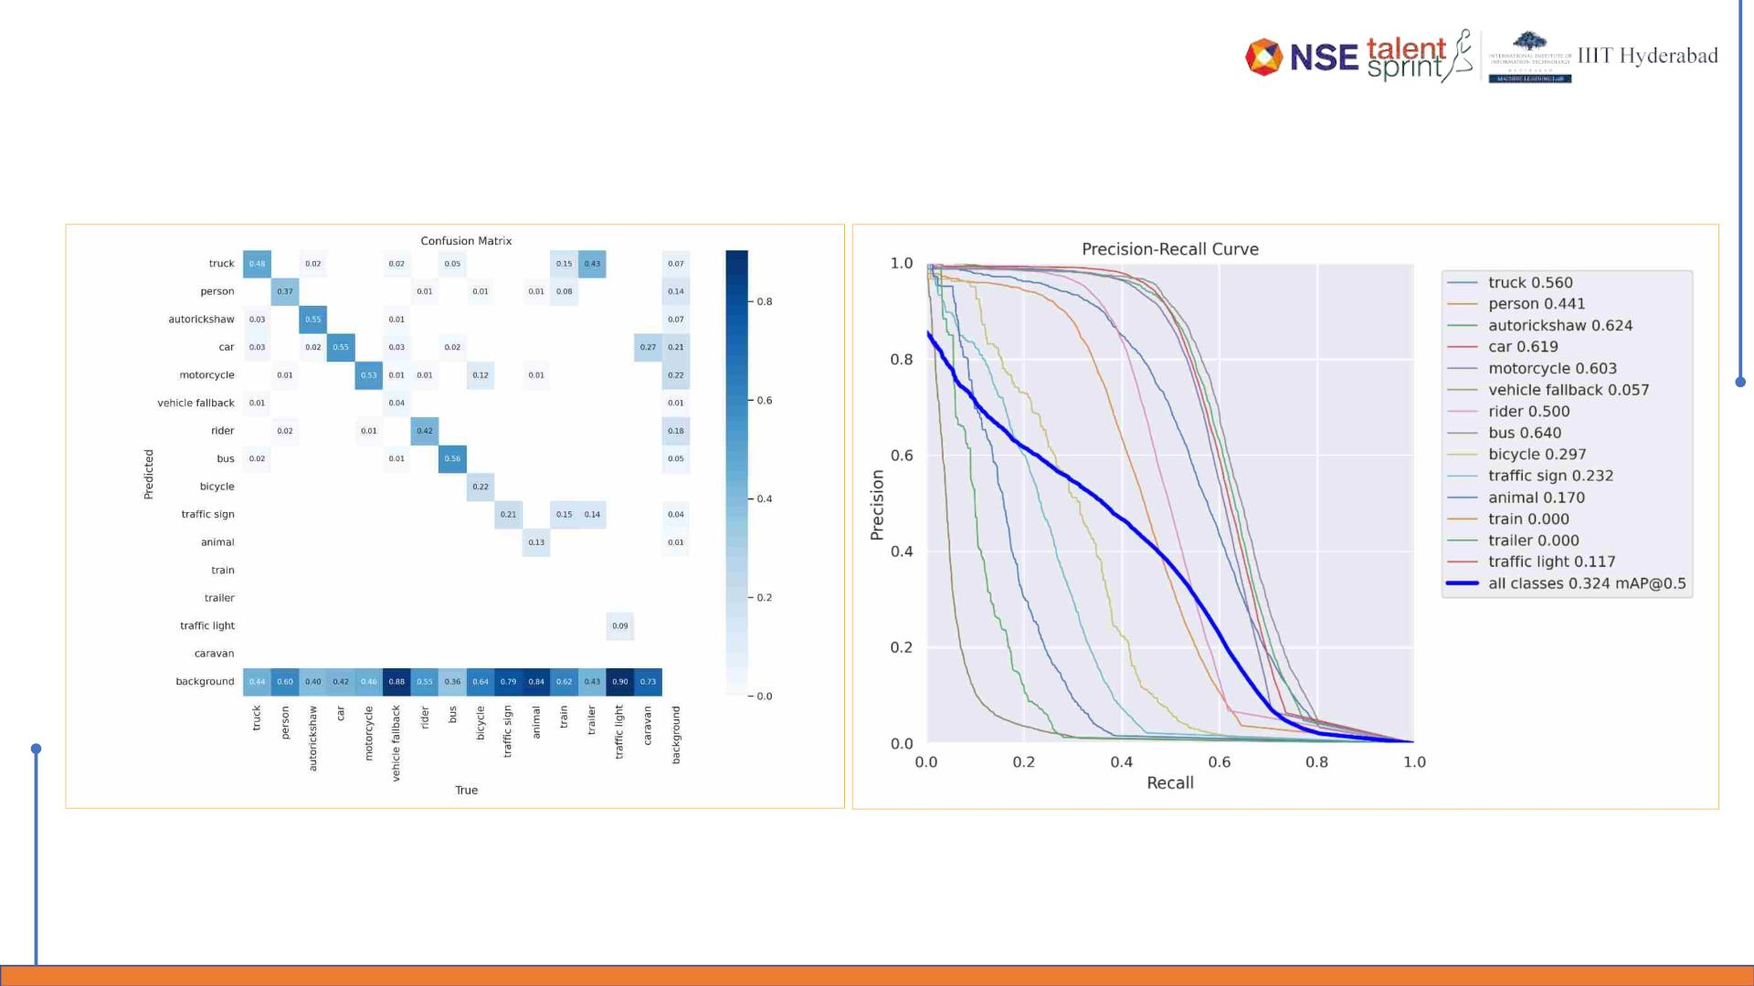
Actual Outcomes
Confusion Matrix & P-R Curves

Slide 29
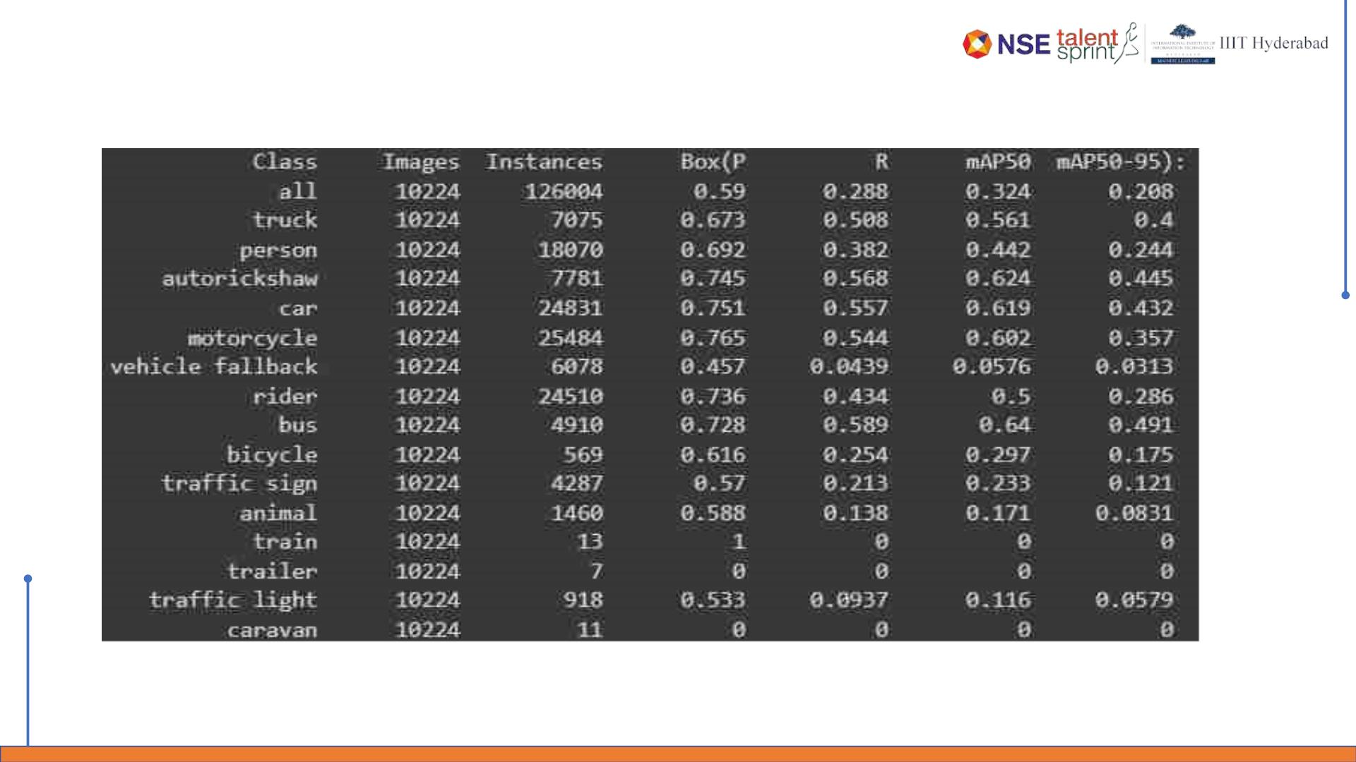
Actual Outcomes
Validation Metrics

Slide 30
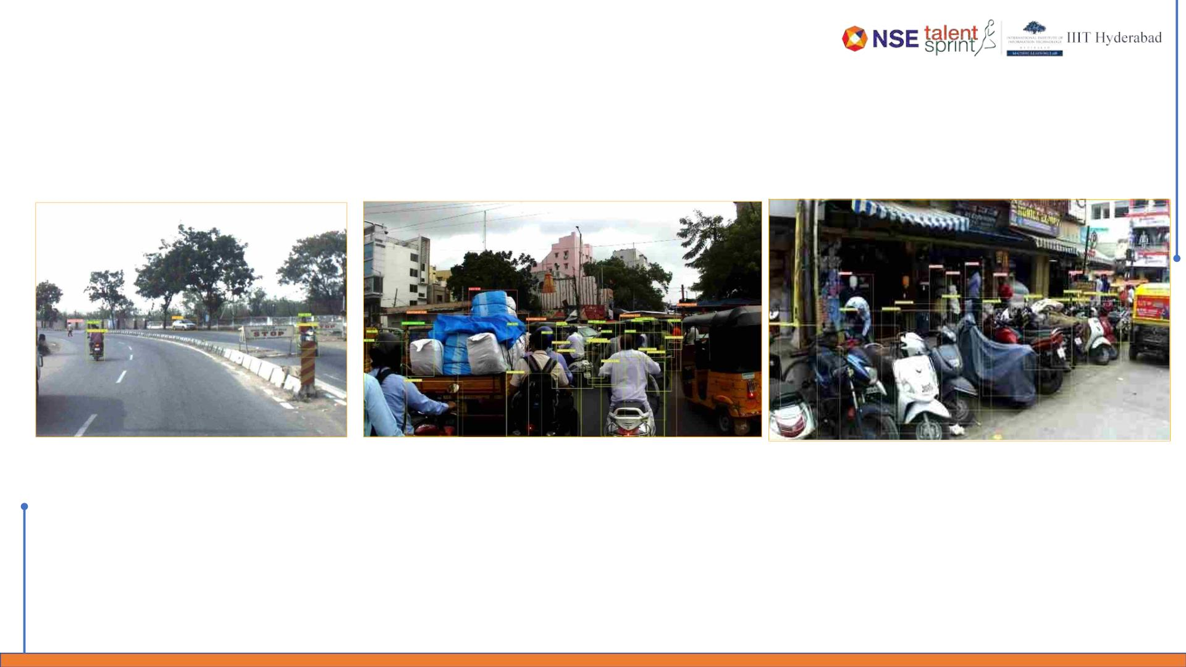
Actual Outcomes
YOLOv8 Object Detection
BDD100K
dataset
training

Slide 31
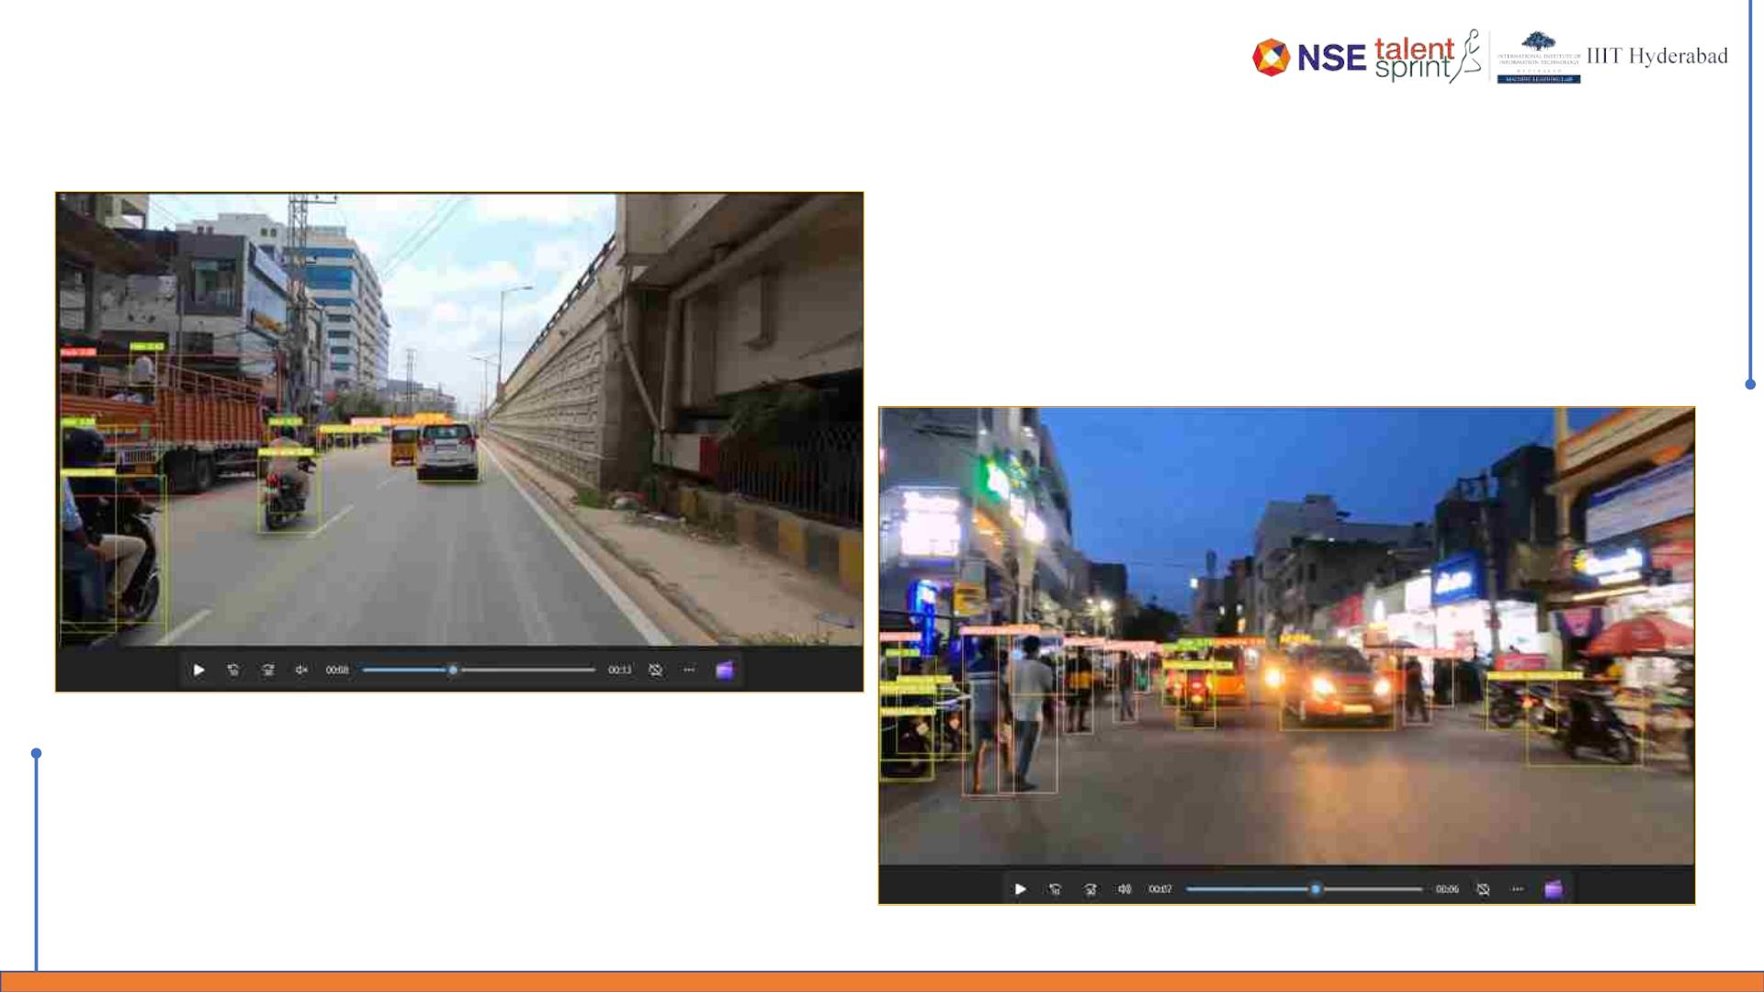
Actual Outcomes
YOLOv8 Object Detection - Videos
dataset
training

Slide 32
Stretch Goals
YOLOv8 –Semantic segmentation on IDD dataset (IN PROGRESS)
q Completed:
§ Explored semantic segmentation using YOLO-v8.
§ Downloaded dataset.
§ Understood the label file format.
q In Progress:
§ Script to convert JSON label files to YOLO understandable text file format.
q Future Steps:
§ Training
§ Review Train and validation metrics
§ Review image and video results.

Slide 33
Application Demo

Slide 34
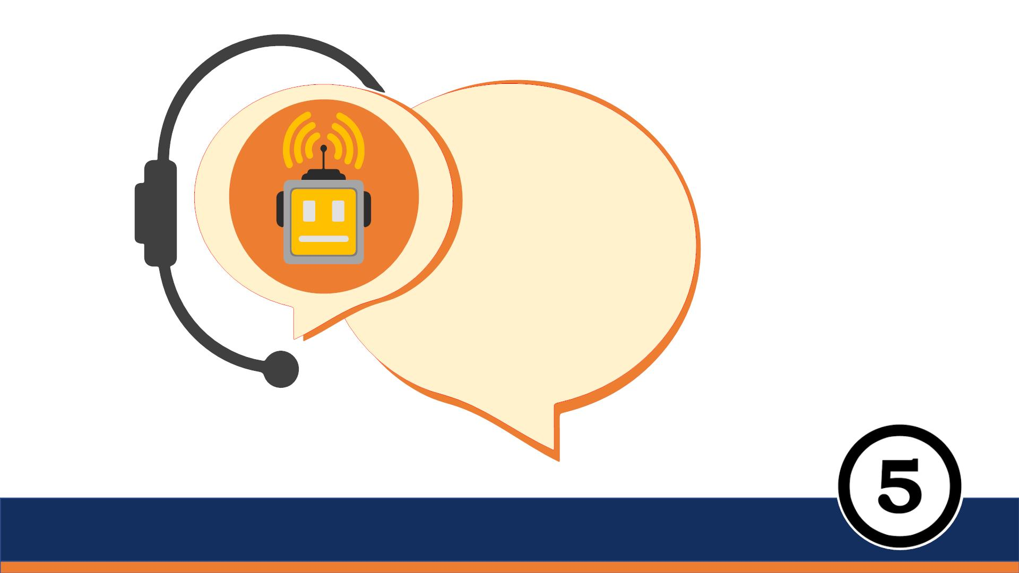
Thank
You

